Slide 1

Cardiovascular Risk Prediction
Done by :
Arun G K
+91 7598409963
arungk.63@gmail.com

Slide 2
Contents
Problem statement and understanding.
Preliminary observations and data cleaning.
Missing values handling and data cleaning.
Exploratory Data Analysis (EDA).
Data Encoding.
Data Balancing by Over sampling.
Model building using Machine learning classification algorithms.
Model performance evaluation and conclusion

Slide 3
Problem statement and understanding
Objective
Develop a predictive model that assesses the Cardiovascular Risk .
The dataset is from an ongoing cardiovascular study on residents of the town of Framingham, Massachusetts. The classification goal is to predict whether the patient has a 10-year risk of future coronary heart disease (CHD). The dataset provides the patients’ information. It includes over 4,000 records and 15 attributes.
In this project, we will be working on predicting the 10-year risk of Coronary Heart Disease (CHD). We are given a set of variables that impact heart diseases. These variables are related to demographic, past, and current medical history
NO | ATTRIBUTES | CATEGORY
1 | AGE | DEMOGRAPHIC
2 | EDUCATION | DEMOGRAPHIC
3 | SEX | DEMOGRAPHIC
4 | SMOKING HABIT | BEHAVIOURAL
5 | CIGARETTES PER DAY | BEHAVIOURAL
6 | BLOOD PRESSURE MEDICATION | MEDICAL (HISTORY)
7 | PATIENT HAD PREVIOUSLY HAD A STROKE | MEDICAL (HISTORY)
8 | PATIENT WAS HYPERTENSIVE | MEDICAL (HISTORY)
9 | PATIENT HAD DIABETES | MEDICAL (HISTORY)
10 | TOTAL CHOLESTEROL LEVEL | MEDICAL(CURRENT)
11 | SYSTOLIC BLOOD PRESSURE | MEDICAL(CURRENT)
12 | DIASTOLIC BLOOD PRESSURE | MEDICAL(CURRENT)
13 | BODY MASS INDEX | MEDICAL(CURRENT)
14 | HEART RATE | MEDICAL(CURRENT)
15 | GLUCOSE LEVEL | MEDICAL(CURRENT)

Slide 4
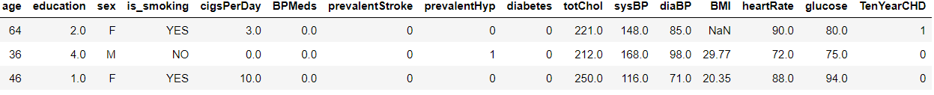
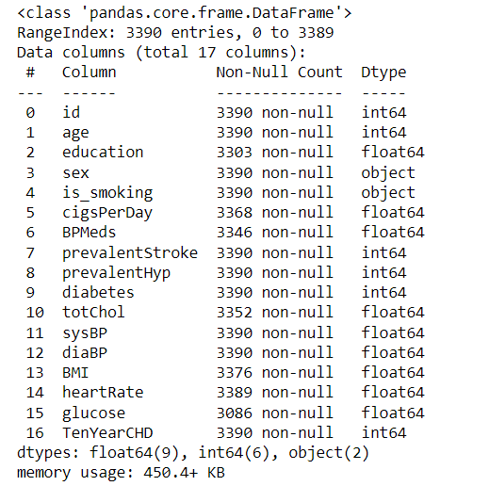

Preliminary observations
There are 17 variables (16 independent and 1 target) and 3390 samples in the data set.
Ten Year CHD is target variable and we need to predict Cardiovascular Risk based on 16 variables.
Out of 16 independent variable 2 are categorical values and 14 are numerical values.
Id column has no relevance in the data analysis and it can be dropped.
Ten Year CHD considered as independent /target variable and others can be considered a depended variable for model.
Ten Year CHD contains two values ‘1’, ‘0’ So it can be considered as a binary classification problem, “1”, means “Yes” there is CHD , “0” means “No” there is no CHD) .

Slide 5
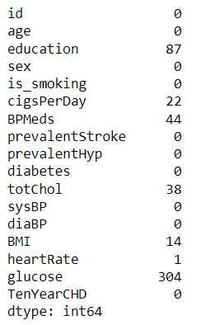
Missing values handling and data cleaning
Missing values are present in the data set
No duplicate values re present in the data set.
So we need to handle missing values in identified variables.

Slide 6
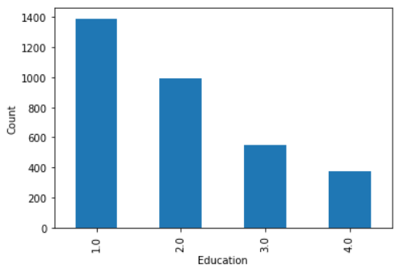
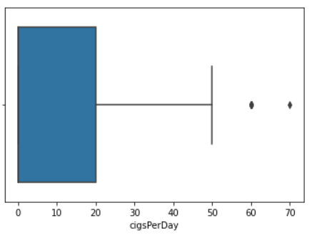
Missing values handling and data cleaning
Education
#1 - Higher Secondary, #2- Graduate, #3 - Post Graduate,#4- Doctorate or PHD
There were 87 missing values in education
It is observed that most of patients are youngsters and as education is higher secondary
Even though the values have data type float , it can be considered as categorical value , So the missing value is filled with mode of data set that is category 1.
Cigarettes per day
There are 22 missing values
we could consider 60 and 70 as outliers , But if we consider 17 hours a day (7 hours sleeping ), It is 4 cigarettes per hours ,
There are chances for that it will be rare.
So not removing this values, and considering median for filling null values ie zero Cigarettes smoking per day

Slide 7
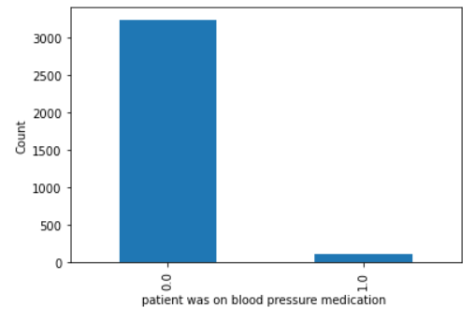
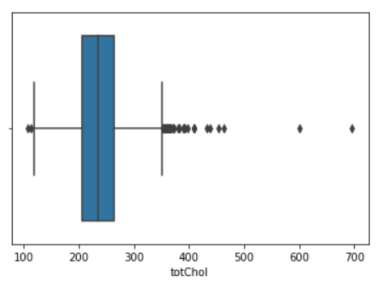
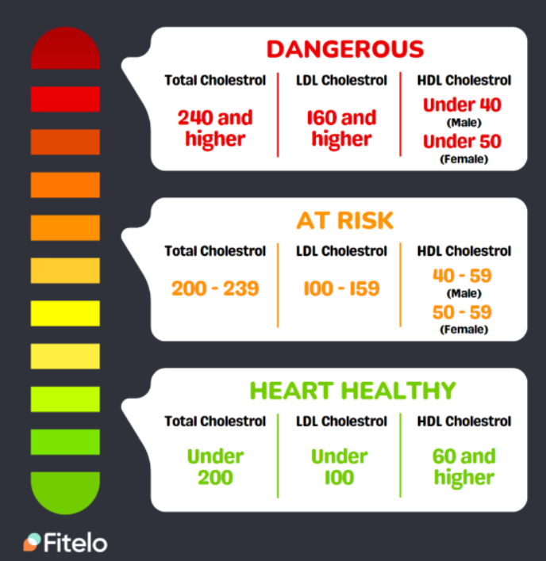
Missing values handling and data cleaning
BP Meds
BP Meds - whether or not the patient was on blood pressure medication (Nominal)
BP Meds has 44 missing values
It is observed that most of people under study was not in medication for blood pressure
So filling the missing values with mode the is no medication was done for blood pressure (0)
Total cholesterol level
There are 38 missing values
From study it is understood that total cholesterol level above 240 is considered as dangerous. So 600 and 700 range are considered as outliers are it far out of the normal range.
There were two samples with total cholesterol level above 600 and both samples dropped. Then null values are filled with mean value.

Slide 8
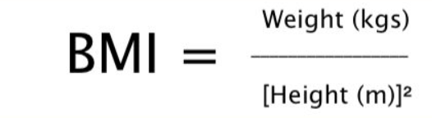
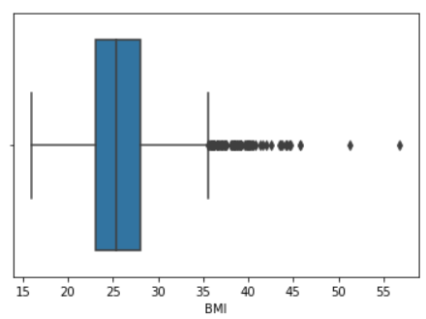
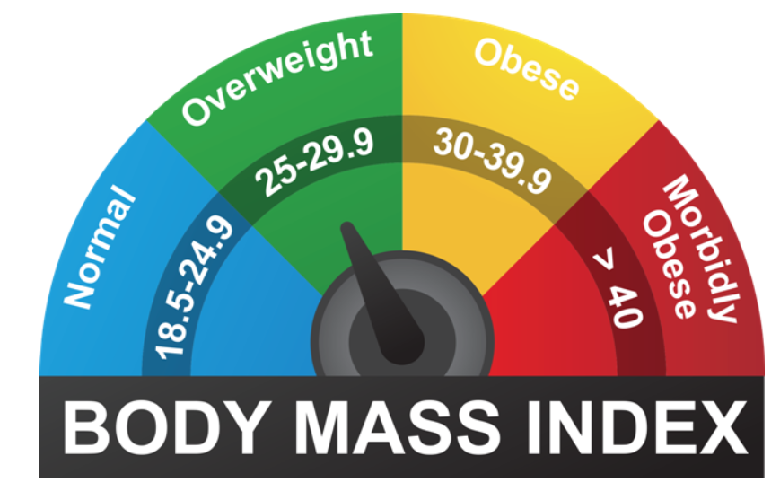
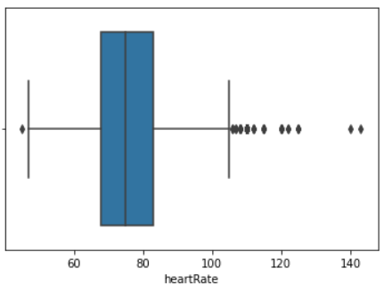
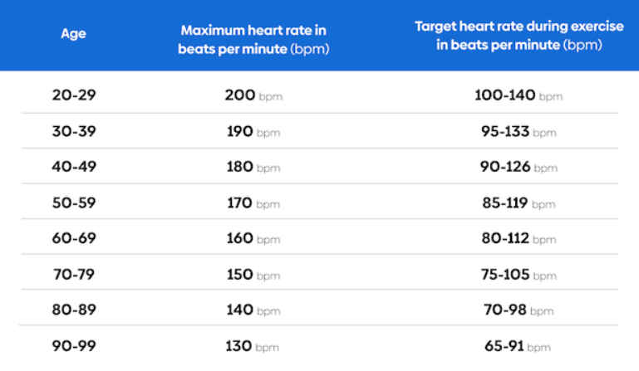
Missing values handling and data cleaning
BMI
BMI: Body Mass Index
BMI has 14 missing values
Values are in expected range as per chart and no values are considered as outliers
Missing values are replaced with mode
Heart rate
There is one missing value
Values are in expected range as per chart and no values are considered as outliers
Missing value filled with mean

Slide 9
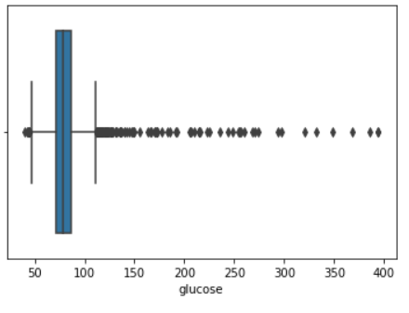
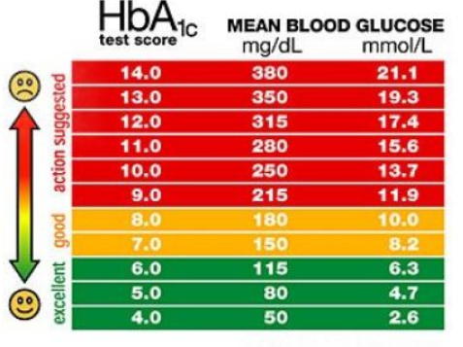
Missing values handling and data cleaning
Glucose level
There are 304 missing values
Values are in expected range as per chart and no values are considered as outliers
Missing values are replaced with median

Slide 10
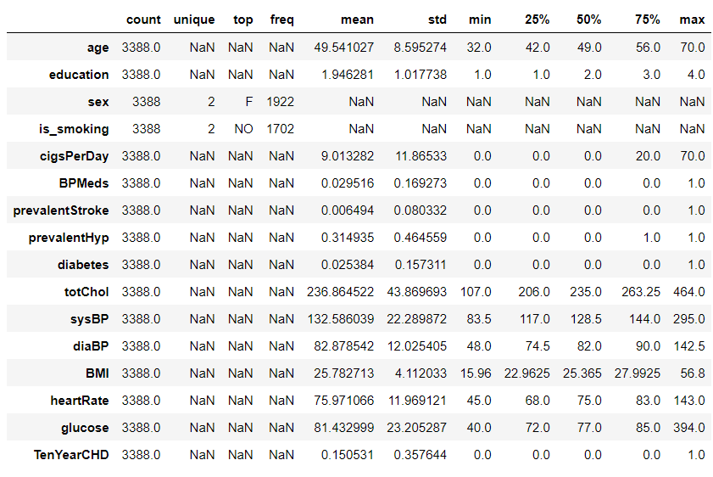
Exploratory Data Analysis (EDA)
id column is dropped before EDA
Categorical and Numerical features analyzed separately.
For all the numerical values mean and median are aligned , So we can rule out possibility of outliers in the data

Slide 11
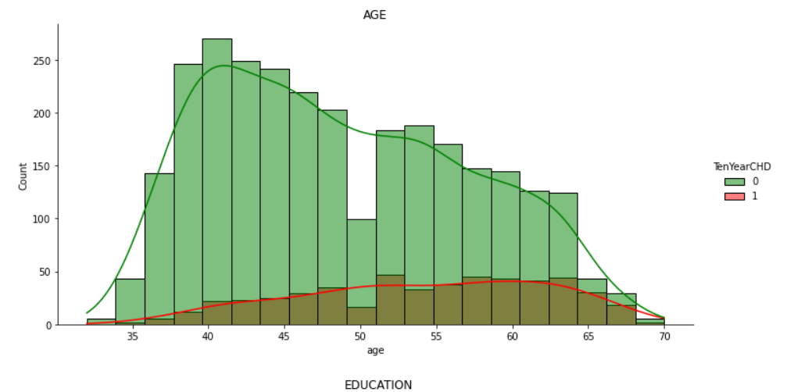
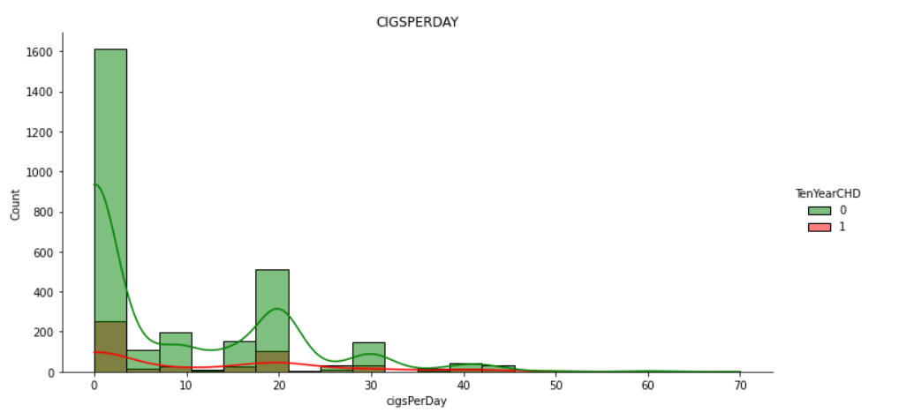
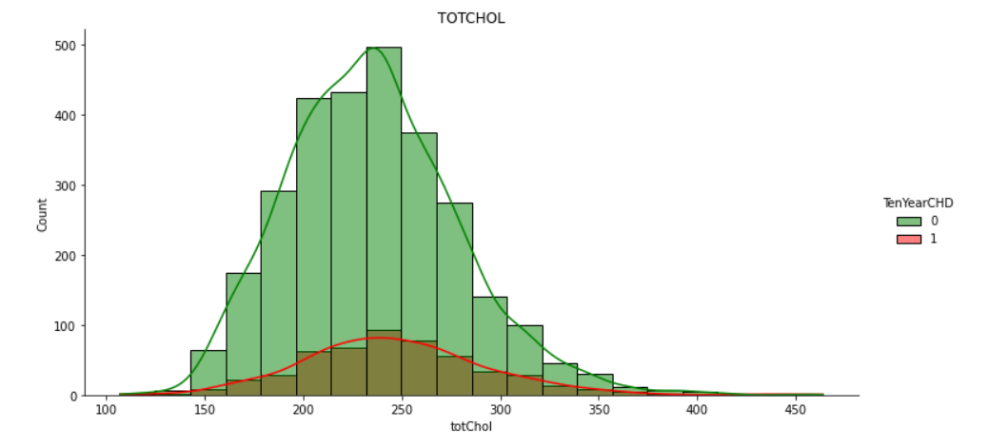
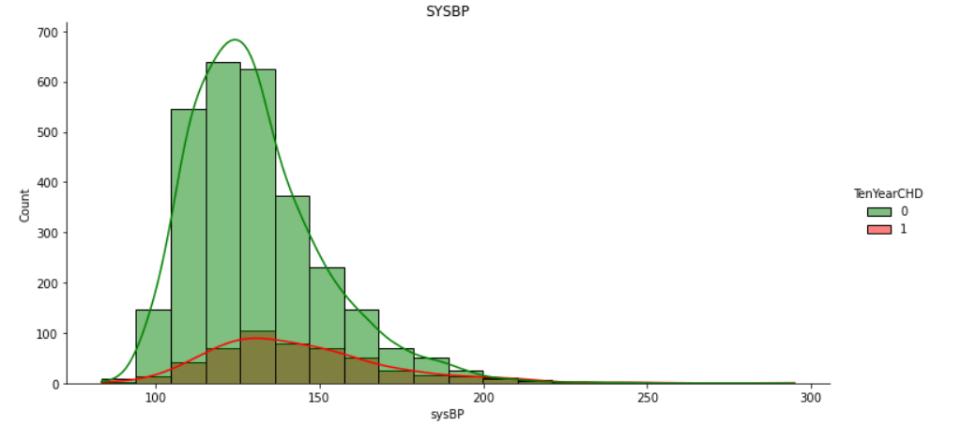
Exploratory Data Analysis (EDA)
Higher chance of coronary heart disease is more between age of 55 to 65
More the number of cigarettes per day higher is the chance for coronary heart disease. But CHD is also observed in people with no smoking habit that is zero cigarettes per day.
Total cholesterol above 240 is dangerous and there a higher chance for coronary heart disease
Systolic blood pressure above 140 is high blood pressure and chances of coronary heart disease is more.

Slide 12
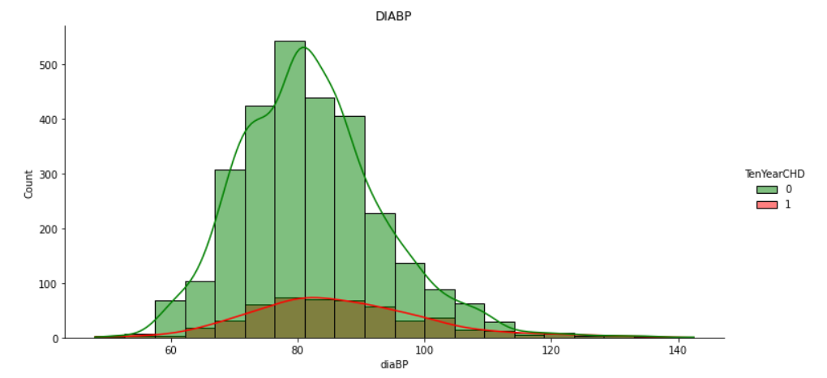
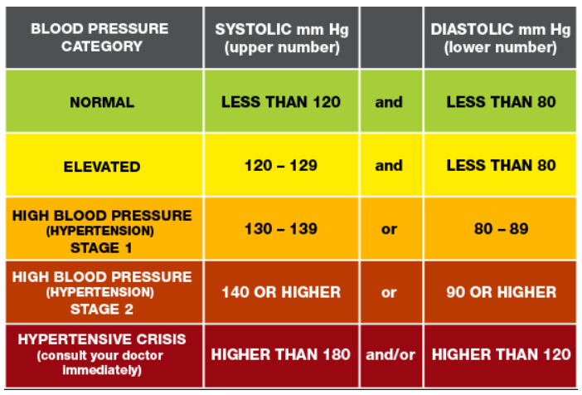
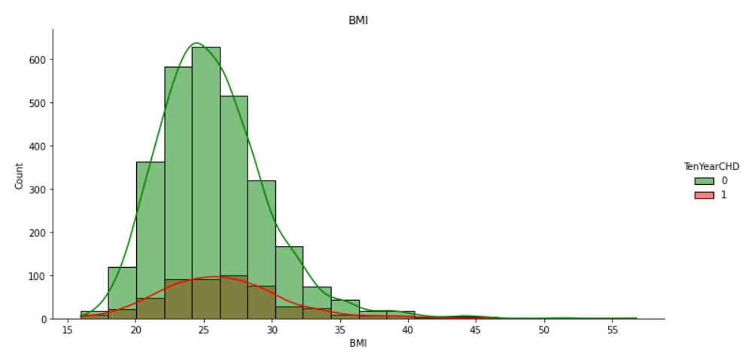
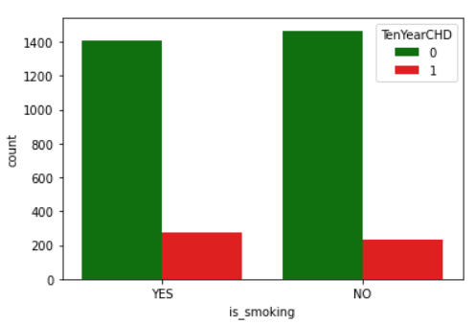
Exploratory Data Analysis (EDA)
Diastolic blood pressure above 80-90 is high blood pressure and chances of coronary heart disease is more.
BMI above 25 is overweight and there is higher chance for coronary heart disease.
CHD is also observed in people with no smoking habit.

Slide 13
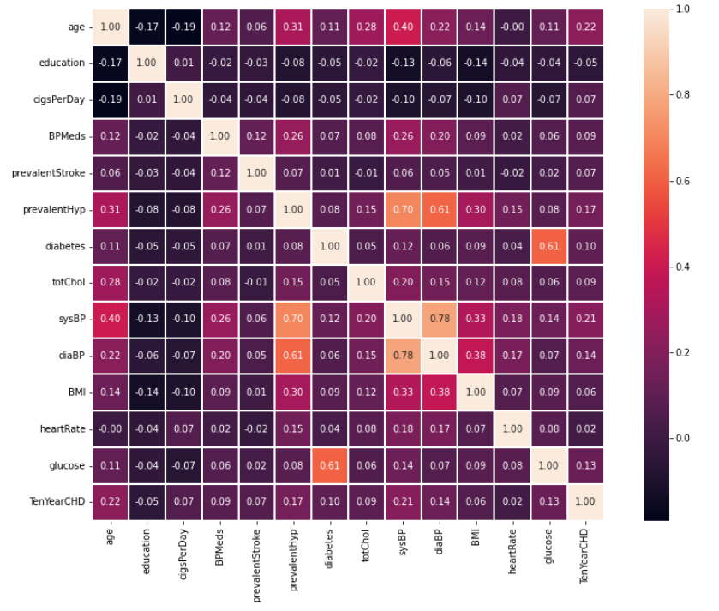
Exploratory Data Analysis (EDA)
Checking Correlation between the features
There is high positive correlation between systolic blood pressure and diastolic blood pressure (0.78)
Systolic blood pressure is positively correlated whether or not the patient was hypertensive (0.70)

Slide 14
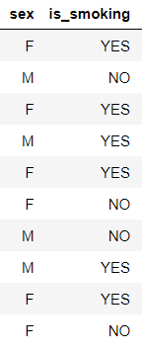
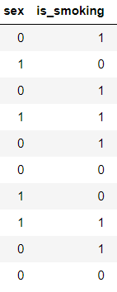
Data Encoding
Encoding is a technique of converting categorical variables into numerical values so that it could be easily fitted to a machine learning model.
Categorical variables with binary values are encoded with Label encoder.
Sex M –> 1 and F –> 0
Is smoking YES -> 1 and NO -> 0

Slide 15
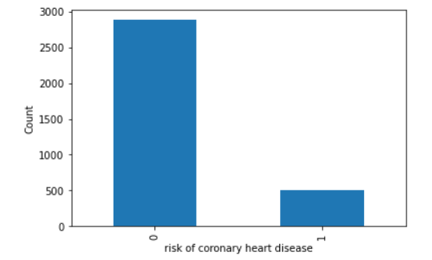
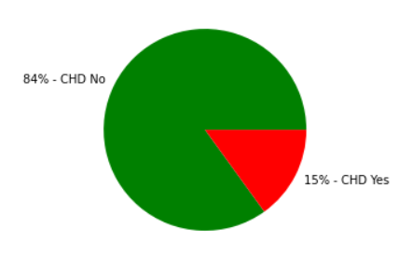
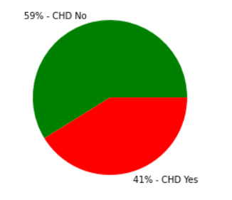
Data Balancing by Over sampling
Imbalanced data refers to those types of datasets where the target class has an uneven distribution of observations, i.e one class label has a very high number of observations and the other has a very low number of observations
The target variable is checked and it is identified that data is highly imbalanced.
It is checked using thumb rule : whether minor data x 2 >= major data
84% values is ‘0’ and represents do not have CHD and 15 % is ‘1’ and represents have CHD
If we build model based on this the model will be biased .
Data balancing is done using oversampling technique (SMOTE).
After oversampling 59 % values is ‘0’ and represents do not have CHD and 41 % is ‘1’ and represents have CHD
Test train is split is done with 80% train sample and 20% test sample.

Slide 16
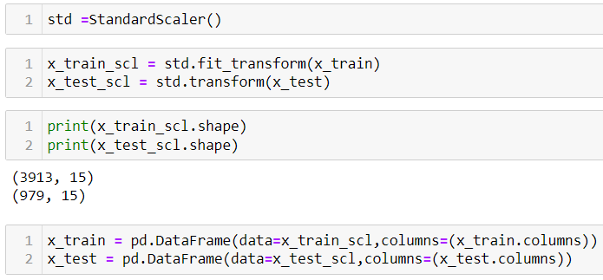
Feature scaling
Feature scaling is the process of normalizing the range of features in a dataset.
Cardiovascular Risk datasets contains features that are varying in degrees of magnitude, range, and units. Therefore, in order for machine learning models to interpret these features on the same scale, we need to perform feature scaling.
It can be done with standard scalar (converting data to standard normal distribution)
Train data is standardized using fit and transform and test data using only transform. So that test data will not learn any mean and SD values.
This data is used to build multiple models

Slide 17
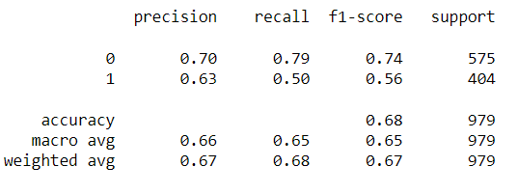
Machine learning Model building
1.Logistic regression
Logistic regression is one of the most popular Machine Learning algorithms, which comes under the Supervised Learning technique.
It is used for binary classification model, As we have binary target value we could use this for model building.
Independent variables and target variable of train data set is fitted to linear regression model.
Target variable is predicted using the test data set and model .Classification report is prepared using predicted data set and actual test data set of target variable.
From classification report it is observed that model
accuracy score - 68%
Recall score – 50%
Precision score – 63%

Slide 18
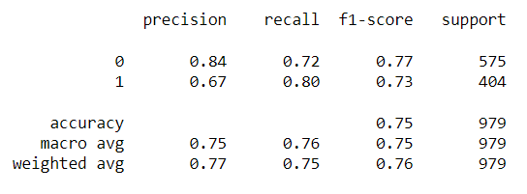
Machine learning Model building
2.K-Nearest Neighbour (KNN)
K-Nearest Neighbour is one of the simplest Machine Learning algorithms based on Supervised Learning technique.
K-NN algorithm assumes the similarity between the new case/data and available cases and put the new case into the category that is most similar to the available categories
Independent variables and target variable of train data set is fitted to K-Nearest Neighbour model.
Target variable is predicted using the test data set and model .Classification report is prepared using predicted data set and actual test data set of target variable.
From classification report it is observed that model
accuracy score - 75%
Recall score – 80%
Precision score – 67%

Slide 19
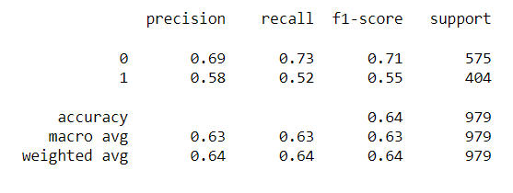
Machine learning Model building
3.Naïve Bayes Classifier
Naïve Bayes algorithm is a supervised learning algorithm, which is based on Bayes theorem and used for solving classification problems.
Naïve Bayes Classifier is one of the simple and most effective Classification algorithms which helps in building the fast machine learning models that can make quick predictions. It is a probabilistic classifier, which means it predicts on the basis of the probability of an object.
BernoulliNB is used as the target variable is binary. Independent variables and target variable of train data set is fitted to Naïve Bayes model.
Target variable is predicted using the test data set and model .Classification report is prepared using predicted data set and actual test data set of target variable.
From classification report it is observed that model
accuracy score - 64%
Recall score – 52%
Precision score – 58%

Slide 20
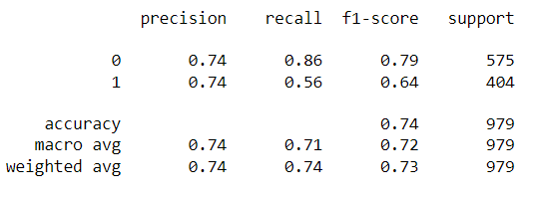
Machine learning Model building
4. Support Vector Machine
Support Vector Machine or SVM is one of the most popular Supervised Learning algorithms, which is used for Classification as well as Regression problems. However, primarily, it is used for Classification problems in Machine Learning.
The goal of the SVM algorithm is to create the best line or decision boundary that can segregate n-dimensional space into classes so that we can easily put the new data point in the correct category in the future. This best decision boundary is called a hyperplane.
Independent variables and target variable of train data set is fitted to Support Vector Machine model.
Target variable is predicted using the test data set and model .Classification report is prepared using predicted data set and actual test data set of target variable.
From classification report it is observed that model
accuracy score - 74%
Recall score – 56%
Precision score – 74%

Slide 21
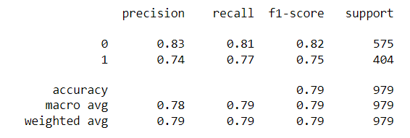
Machine learning Model building
5. Decision Tree Classifier
A decision tree is one of the most powerful tools of supervised learning algorithms used for both classification and regression tasks. It builds a flowchart-like tree structure where each internal node denotes a test on an attribute, each branch represents an outcome of the test, and each leaf node (terminal node) holds a class label.
It is constructed by recursively splitting the training data into subsets based on the values of the attributes until a stopping criterion is met, such as the maximum depth of the tree or the minimum number of samples required to split a node.
Independent variables and target variable of train data set is fitted to Random Forest model.
Target variable is predicted using the test data set and model .Classification report is prepared using predicted data set and actual test data set of target variable.
From classification report it is observed that model
accuracy score - 79%
Recall score – 77%
Precision score – 74%

Slide 22
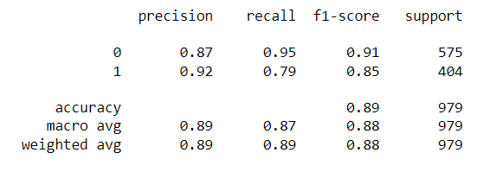
Machine learning Model building
6. Random Forest Classifier
Random Forest is a popular machine learning algorithm that belongs to the supervised learning technique. It is based on the concept of ensemble learning, which is a process of combining multiple classifiers to solve a complex problem and to improve the performance of the model.
As the name suggests, "Random Forest is a classifier that contains a number of decision trees on various subsets of the given dataset and takes the average to improve the predictive accuracy of that dataset." Instead of relying on one decision tree, the random forest takes the prediction from each tree and based on the majority votes of predictions, and it predicts the final output.
Independent variables and target variable of train data set is fitted to Random Forest model.
Target variable is predicted using the test data set and model .Classification report is prepared using predicted data set and actual test data set of target variable.
From classification report it is observed that model
accuracy score - 89%
Recall score – 79%
Precision score – 92%

Slide 23
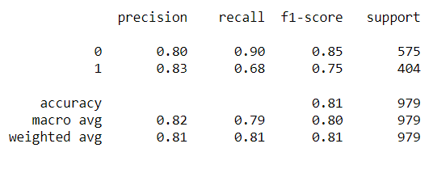
Machine learning Model building
7. Adaboost Classifier
AdaBoost short for Adaptive Boosting is an ensemble learning used in machine learning for classification and regression problems. The main idea behind AdaBoost is to iteratively train the weak classifier on the training dataset with each successive classifier giving more weightage to the data points that are misclassified.
The final AdaBoost model is decided by combining all the weak classifier that has been used for training with the weightage given to the models according to their accuracies. The weak model which has the highest accuracy is given the highest weightage while the model which has the lowest accuracy is given a lower weightage.
Independent variables and target variable of train data set is fitted to Random Forest model.
Target variable is predicted using the test data set and model .Classification report is prepared using predicted data set and actual test data set of target variable.
From classification report it is observed that model
accuracy score - 81%
Recall score – 68%
Precision score – 83%

Slide 24
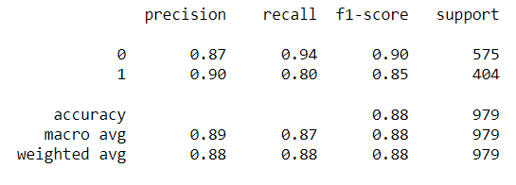
Machine learning Model building
8. XGBoost Classifier
XGBoost is an optimized distributed gradient boosting library designed for efficient and scalable training of machine learning models. It is an ensemble learning method that combines the predictions of multiple weak models to produce a stronger prediction
XGBoost stands for “Extreme Gradient Boosting” and it has become one of the most popular and widely used machine learning algorithms due to its ability to handle large datasets and its ability to achieve state-of-the-art performance in many machine learning tasks such as classification and regression.
Independent variables and target variable of train data set is fitted to Random Forest model.
Target variable is predicted using the test data set and model .Classification report is prepared using predicted data set and actual test data set of target variable.
From classification report it is observed that model
accuracy score - 88%
Recall score – 80%
Precision score – 90%

Slide 25
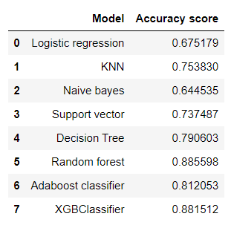
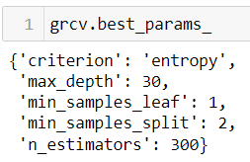

Machine learning Model building
Out of all the models Random forest classifier giving the best Accuracy.
Hyperparameters in Machine learning are those parameters that are explicitly defined by the user to control the learning process. The process of selecting the best hyperparameters to use is known as hyperparameter tuning,
Hyper parameter tuning is tried to get the best parameters for Random forest classifier.
It is done with the help of GridSearchCV
Best parameters are identified and checked the latest accuracy score and it is observed that accuracy is improved slightly to 89.3 %
K fold cross validation score is also calculated for Random forest model and average accuracy score of 89.2% is attained.

Slide 26
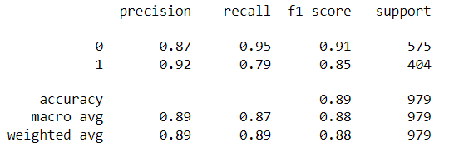
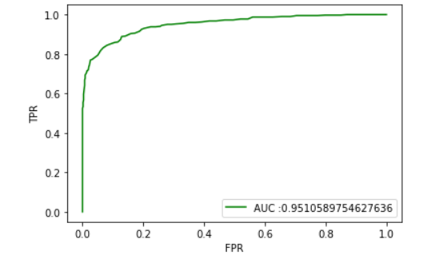
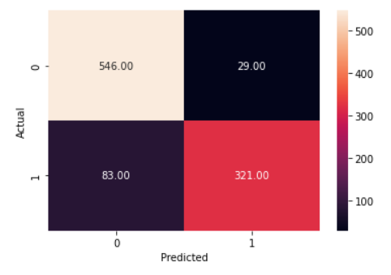
Model performance evaluation and conclusion
Out of all the models Random forest classifier giving the higher performance. Performance improved slightly by using hyper parameter tuning.
Model evaluation for Random forest model is done with confusion matrix and ROC_AUC
From Confusion matrix the below values can be concluded
True Positive (TP) = 321
True Negative (TN) = 546
False Positive (FP) = 29
False Negative (FN)= 83
AUC score value is 0.95

Slide 27
Conclusion
Out of all the models Random forest classifier model giving the best performance and it is proposed for the Cardiovascular Risk Prediction.
XGBoost Classifier model is also giving the performance near to Random forest model with an accuracy of 88%.
Random forest classifier model can be deployed for Cardiovascular Risk Prediction and as per model evaluation results it should give 89% accuracy.

Slide 28
THANK YOU…!!

